Slide 1
Linear prediction and optimal filtering
2018

Slide 2
Table of contents
Introduction
Terms and definitions
Representation of stochastic processes
Models for random processes
Relationships between filter parameters and autocorrelation sequence
Forward prediction
Backward prediction
Relationships between prediction errors and lattice structure
Normal equations
Data Compression by Linear Prediction
Wiener filter for filtering and prediction

Slide 3
Introduction
What?
Estimate following sample(s) of a signal given previous ones
Why?
Coding, Speech synthesis, ECG/EEG analysis, Signal
Enhancement, Adaptive filtering and many more

Slide 4
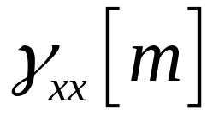
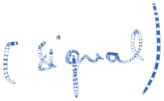
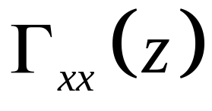




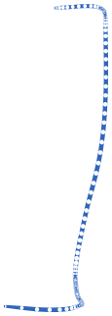
Representation of stationary stochastic processes. Regulated processes. Spectral factorization
Notations:
x[n] wide sense stationary process
autocorrelation sequence
power spectral density
A stationary stochastic process {x[n]} can be represented as the output of an IIR filter with system function H(z) , excited by a white noise sequence {w[n]}.

Slide 5

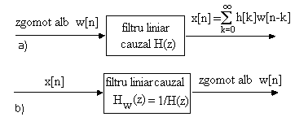
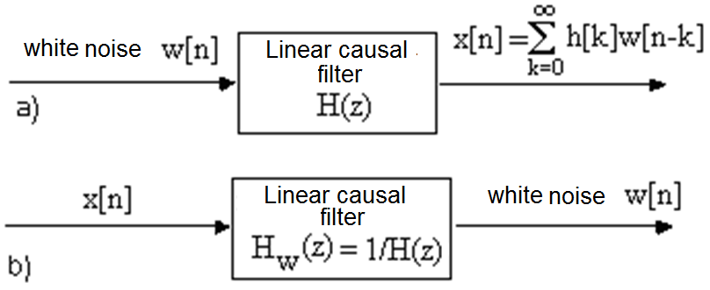

Representation of stationary stochastic processes. Regulated processes. Spectral factorization
Fig. 1. Filters for generating: a) the random process from white noise,
b) the inverse filter

Slide 6
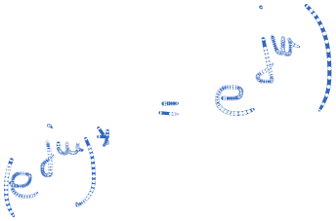


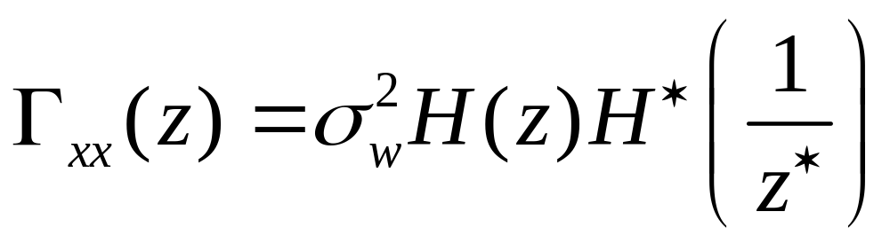

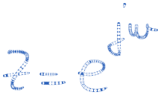


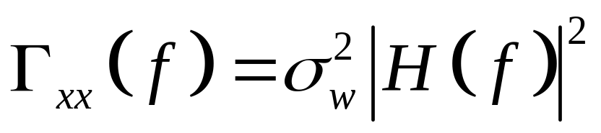
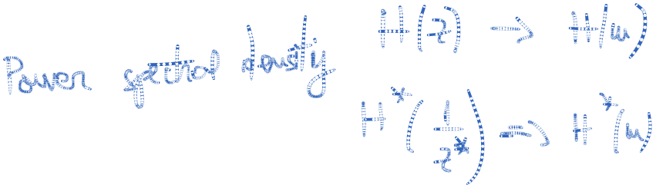

Representation of stationary stochastic processes. Regulated processes. Spectral factorization
Regulated process
In frequency domain

Slide 7
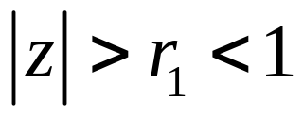
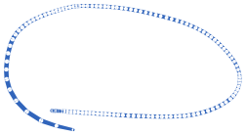

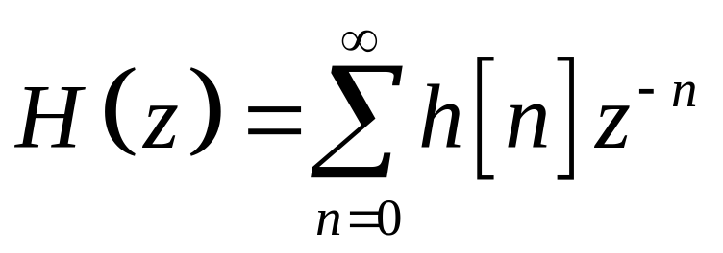
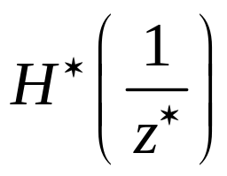
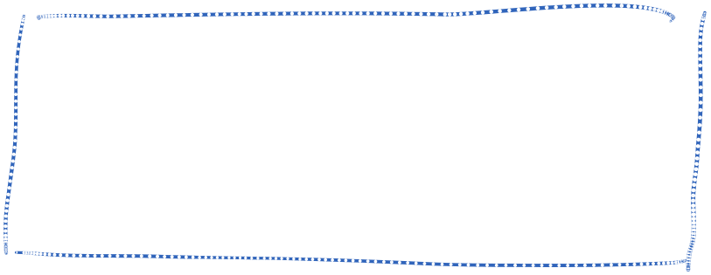
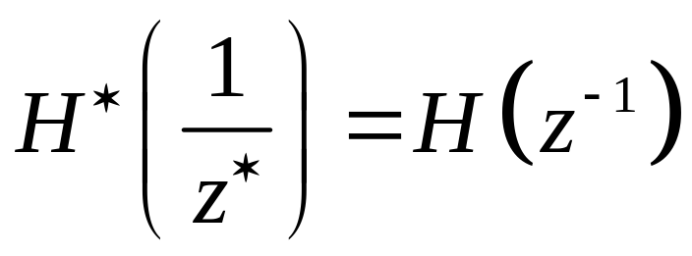
Representation of stationary stochastic processes. Regulated processes. Spectral factorization
H(z) – analytical in
The causal part – associated with
The anticausal part – associated with
  For processes with real values
(10)
(11)

Slide 8
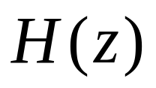
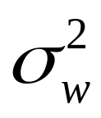
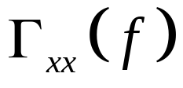


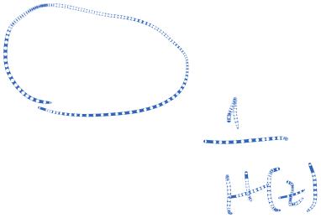
Representation of stationary stochastic processes. Regulated processes. Spectral factorization
The output of to a white noise input sequence w[n] with power spectrum density is a stationary random process {x[n]} with power spectrum density
Conversely, the stationary random process with power spectrum density can be transformed into a white noise process by passing {x[n]} through a linear filter with system function 1/H(z).

Slide 9
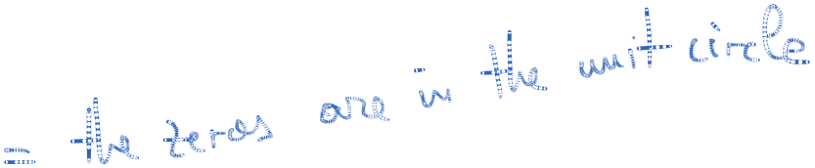
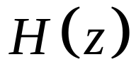
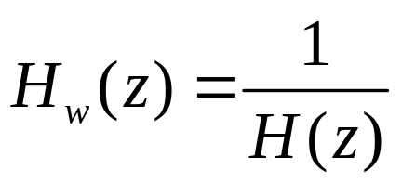

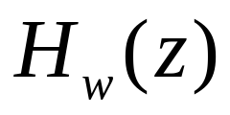



Representation of stationary stochastic processes. Regulated processes. Spectral factorization
minimum phase
The inverse system – whitening filter
The convergence regions for and are different
Stability – minimum phase

Slide 10
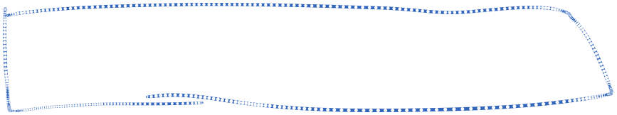
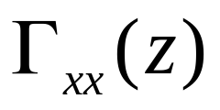
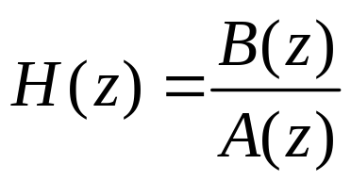
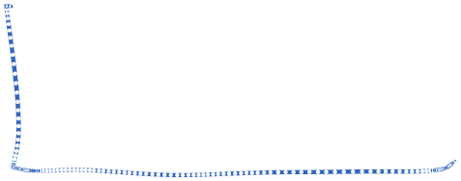
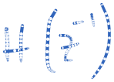

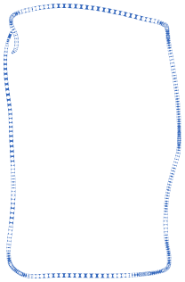
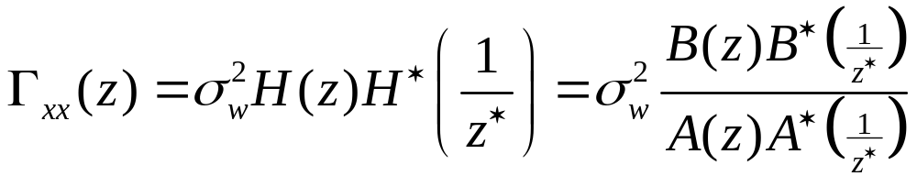

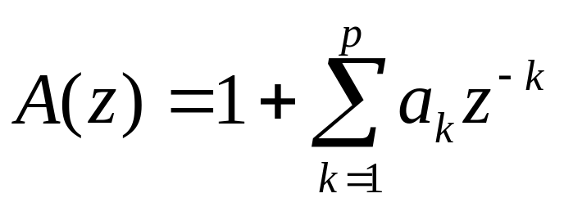
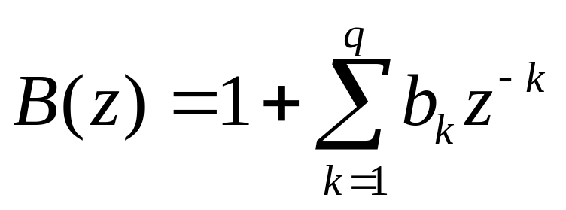




Rational power spectra
- a rational function

Slide 11
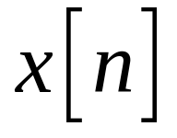
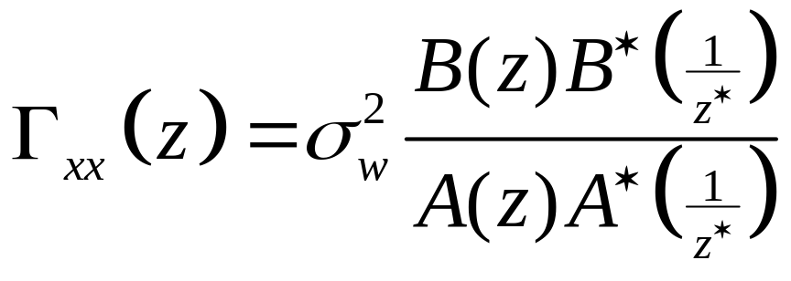



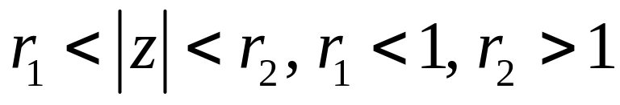
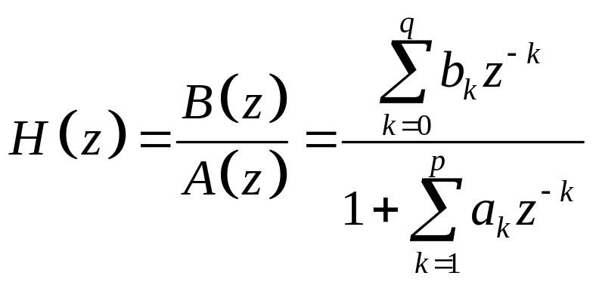
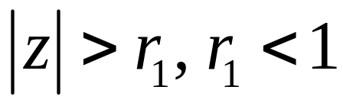
Models for random processes
a random process with rational power spectral density
;
(16)
(17)

Slide 12

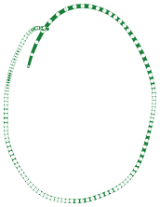
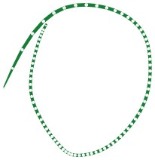
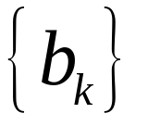
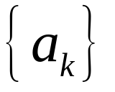

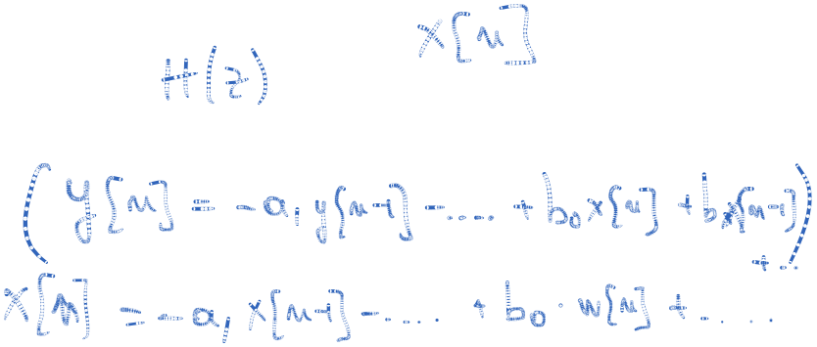




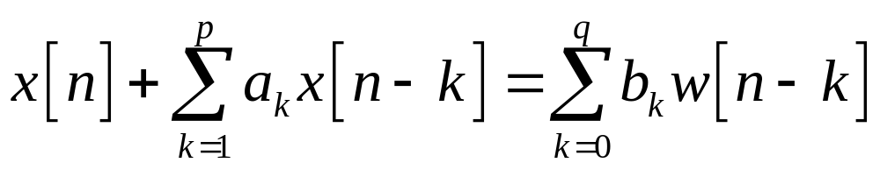




Models for random processes
and the filter coefficients
w[n] white noise
The difference equation
(18)

Slide 13

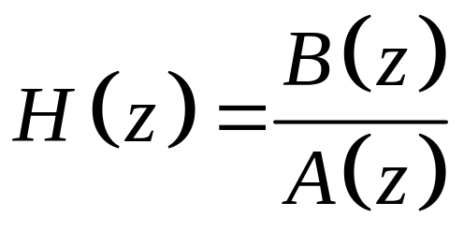
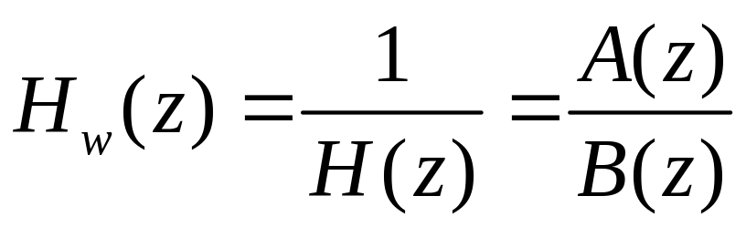

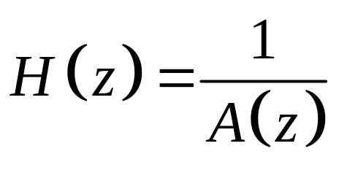
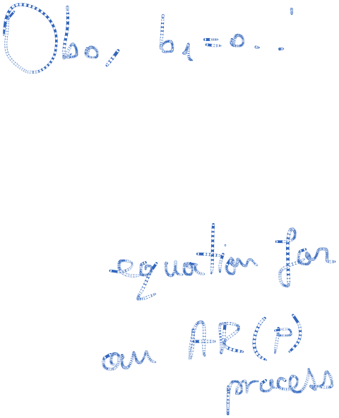
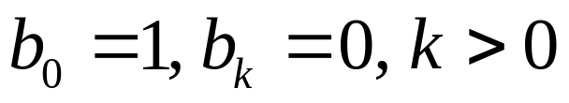






Models for random processes
Three cases:
  a) Autoregressive, moving average (ARMA) process
  b) Autoregressive (AR) process
(19)

Slide 14






Models for random processes
  c) Moving average (MA) process
Rational model:
1- Simple numerical evaluation of model parameters
2 - Accurate approximation of an arbitrary spectrum
(20)

Slide 15
Models for random processes
Focus on AR models
  Widely used
  Easier to implement
  Better suited for signals with sharp peak spectra
  Any transfer function can be approximated by an (possibly infinite) AR model
Estimate parameters by direct/iterative methods
Time/frequency methods
Input can be represented by white noise or impulse trains

Slide 16




Relationships between the filter parameters and the autocorrelation sequence
(21)
(22)

Slide 17







Relationships between the filter parameters and the autocorrelation sequence
(24)
(25)

Slide 18


Relationships between the filter parameters and the autocorrelation sequence
For AR processes
(26)

Slide 19










Relationships between the filter parameters and the autocorrelation sequence
Linear relation between and
Yule-Walker equations - matrix form
(27)

Slide 20
Relationships between the filter parameters and the autocorrelation sequence
Advantages:
  Toeplitz matrix (easy to inverse)
  Positive semidefinite
Disadvantages:
  In real scenarios we do not have access to all samples
  Use a unite support window

Slide 21

Relationships between the filter parameters and the autocorrelation sequence
For MA processes
Determination of model parameters based on autocorrelation function (estimated)
Determination of autocorrelation function based on model parameters (recursive)
(28)

Slide 22




Forward prediction
stationary random process
the estimation of order p with r
steps of the sample
forward prediction

Slide 23





Forward prediction
One step forward linear predictor (r=1)

Slide 24

Forward prediction
Fig. 1. Forward linear predictor one step, order p

Slide 25


Forward prediction
Forward prediction error
(2)
Fig. 2. Prediction error filter

Slide 26


Forward prediction
(3)
Fig. 3. Prediction error filter

Slide 27


Forward prediction
Minimize the total mean square forward prediction error
(4)

Slide 28


Forward prediction
By
We obtain the normal equations
(5)

Slide 29


Forward prediction
and minimum squared error:
This extreme is a minimum one
(7)
(8)

Slide 30





Backward prediction
Estimate the sample based on backward prediction, r steps, order p.
For r=1, we estimate from data sequence
(9)

Slide 31


Backward prediction
Backward linear prediction error
Fig. 4. One step backward predictor, order p

Slide 32


Backward prediction
(10)
(11)

Slide 33

Backward prediction
Fig. 5. Backward prediction error filter

Slide 34


Backward prediction
The backward prediction error
The mean square backward prediction error
(12)
(13)

Slide 35


Backward prediction
Minimize
By
We get
(15)
(16)

Slide 36


Backward prediction
The extreme in a minimum

Slide 37

Relationships between prediction errors and lattice structure
Figura 4. lattice filter, (b) m – stage structure

Slide 38





Relationships between prediction errors and lattice structure
(17)
(18)
(19)

Slide 39







Relationships between prediction errors and lattice structure
m = 1, 2, . . . , M-1
m = 1, 2, . . . , M-1
m = 1, 2, . . . , M-1
m = 1, 2, . . . , M-1
(27)
(28)
(29)
(30)
(31)
(32)
(33)

Slide 40




Relationships between prediction errors and lattice structure
(41)
(42)
(43)

Slide 41




Relationships between prediction errors and lattice structure
=
(19)
(20)

Slide 42


Relationship between linear prediction and an AR process
AR process
For a predictor
(23)

Slide 43


Relationship between linear prediction and an AR process
Observations:
        Model AR(p) Predictor – p steps

Slide 44

Solution of the normal equations
The extended normal equations
(24)
(25)

Slide 45




Levison-Durbin algorithm
(26)

Slide 46


Levison-Durbin algorithm
reflection coefficient
The minimum squared error for a predictor of order m,
(27)

Slide 47



Levison-Durbin algorithm
(28)

Slide 48
Levison-Durbin algorithm
Filter Stability
H (z ) = 1/A(z): Poles inside unit circle
R is positive definite ⇒ stable filter
This property can be lost due to estimations or quantization errors
Check roots of A(z ) ⇒ costly procedure
Check reflection coefficients |K_{m} | < 1, 1 ≤ m ≤ p
Check Em > 0, 1 ≤ m ≤ p
Covariance matrix not always positive definite
Check reflection coefficients (backward recursion)

Slide 49
Data Compression by linear prediction
AR process:
Redundancy removal by predictive coding:
Send filter description
Send prediction error
Stationary signal: filter description sent once
Nonstationary signal: filter description updated periodically

Slide 50
Data Compression by linear prediction
Filter Description
Alternative representations:
Impulse response of A(z ) or H (z ) coefficients (a_{k} or h[n] )
Large number of bits required for quantization
Autocorrelation coefficients for a_{k} or h[n]
Spectral coefficients for A(z ) or H (z )
Cepstral coefficients
Poles of H (z ) or zeros of A(z )
Reflection coefficients

Slide 51
Data Compression by linear prediction
Quantization Properties
Desired properties:
  Stability upon quantization
  Poles of A(z )
  Reflection coefficients
  a_{k} or h[n] coefficients ⇒ susceptible to filter instability
  Autocorrelation coefficients ⇒ susceptible to filter instability
  Spectral coefficients
  Reflection coefficients

Slide 52

Wiener filters for filtering and prediction
Fig. 6. Model for linear estimation problem

Slide 53






Wiener filters for filtering and prediction
- signal
- additive noise
- desired signal
- input signal
- output signal
- error sequence

Slide 54



Wiener filters for filtering and prediction
Three cases:
, filtering
, prediction
smoothing
The criterion selected for optimizing the impulse response is the minimization of mean square error

Slide 55

Wiener filters for filtering and prediction
Sequences
zero mean and wide sense stationary
The optimum linear filter in the sens of MMSE - Wiener filter
The linear filter – FIR or IIR

Slide 56



FIR Wiener filter
The length of the filter is M with coefficients
The filter output
The mean square value of the error
(29)
(30)

Slide 57



FIR Wiener filter
The minimization of
yields Wiener Hopf equations
(31)
(32)

Slide 58






FIR Wiener filter
In matrix form
(35)

Slide 59


FIR Wiener filter
The minimum error is
(36)
(37)

Slide 60




FIR Wiener filter
(38)
If
s[n] and w[n] - uncorrelated
(39)
(40)

Slide 61

FIR Wiener filters
Wiener Hopf equations
(41)
(42)

Slide 62



Orthgonality principle in linear mean square estimation
(43)
(44)

Slide 63


IIR Wiener filter
Minimize the MMSE
(47)
(48)

Slide 64



IIR Wiener filter
Applying orthogonality principle results in Wiener Hopf equations
The MMSE
These equation cannot be solved directly because they hold only for
(49)
(50)

Slide 65




IIR Wiener filter
Recall that
- stationary random process with
autocorrelation and power spectral density .
- output of a system G(z) with impulse response g[n] with white noise input w[n].
The system 1/G(z) whitens the process x[n]
(56)

Slide 66




IIR Wiener filter
The Wiener optimal filter is a cascade of a whitening filter and
Fig 7. Optimal Wiener filter

Slide 67





IIR Wiener filter
Apply the orthogonality principle
The optimality of assures the optimality of
(57)
(58)

Slide 68

IIR Wiener filter
(59)

Slide 69





IIR Wiener filter
As is white noise,
excepting m=k .
The Z transform of
(60)
(61)

Slide 70




IIR Wiener filter
The bilateral Z transform of
Its causal part
(62)
(63)
(64)

Slide 71



IIR Wiener filter
(65)
(66)
(67)

Slide 72

IIR Wiener filter
The Z transform of correlation
(68)

Slide 73



IIR Wiener filter
(69)
(70)
(71)

Slide 74



IIR Wiener filter
(72)
(73)
(74)

Slide 75



Noncausal IIR Wiener filter
We drop the constaint imposed to the filter to be causal
The estimate of the desired signal is
.
Apply the orthogonality principle
Wiener-Hopf equations
(75)
(76)

Slide 76



Noncausal IIR Wiener filter
EPMM
(77)
(78)
(79)

